Slide 1
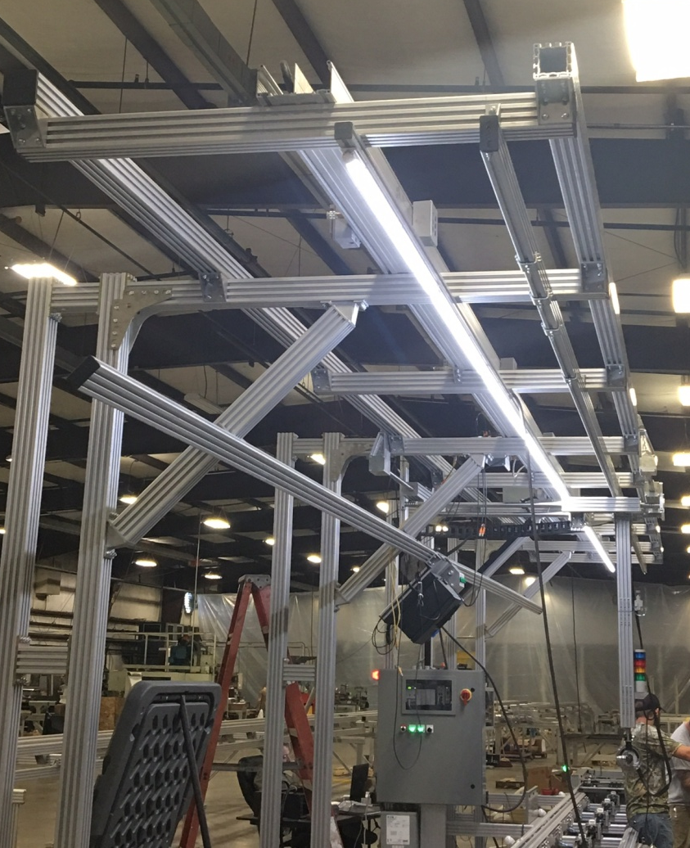
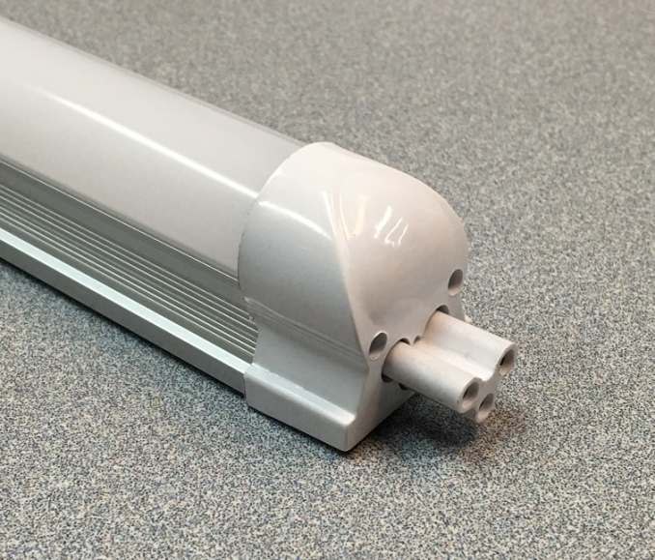
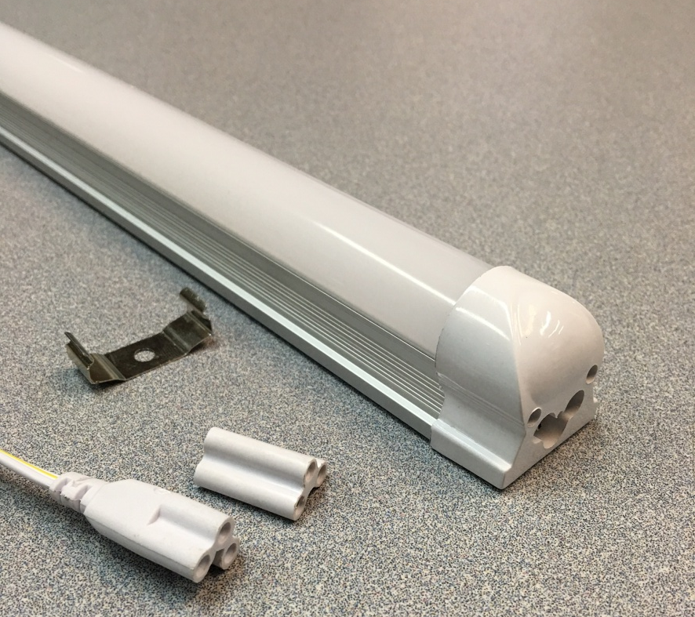
Tekno LED Lighting
Advantages
There are many advantages of using Tekno’s LED Lights:
Extruded aluminum alloy shell provides durability and increased cooling.
UL and CE approved.
Withstand shock, vibrations, frequent switching and temperature extremes which rapidly incapacitate incandescent lamps.
Lifespan of 50,000+ hours.
3 year warranty
One Wall Street
Cave City, KY 42127

Slide 2
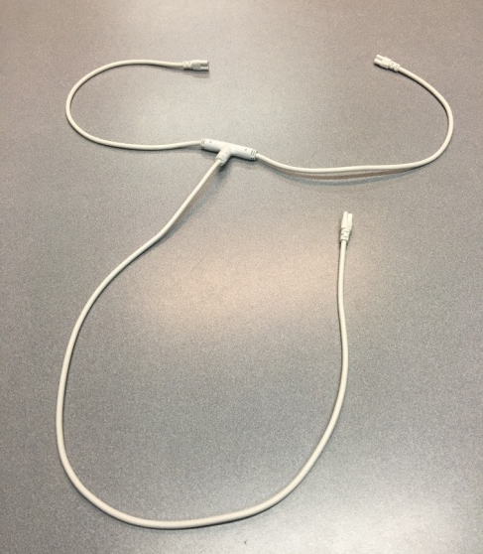
Tekno LED Lighting
Key Features:
Available in either 2’ or 4’ lengths
Frosted cover reduces eyestrain when looking at the lights.
Mounting brackets allow direct mounting to Tekno’s extrusions or other mounting surfaces.
120 LED’s per 4’ light.
4’ Light produces approximately 1,800 lumens.
Lights mounted at 10’ from the floor provide 425 lumens at operator level.
Variety of accessories available including mounting brackets, connectors, straight and T-connector cables and power cords.
Lights connect directly to each other allowing daisy-chaining up to 60’ on 1 circuit.
One Wall Street
Cave City, KY 42127

